Slide 1
B-Tree a B*-Tree
Estructuras de Datos Avanzadas
Emmanuel del Piero Martínez Salcedo

Slide 2

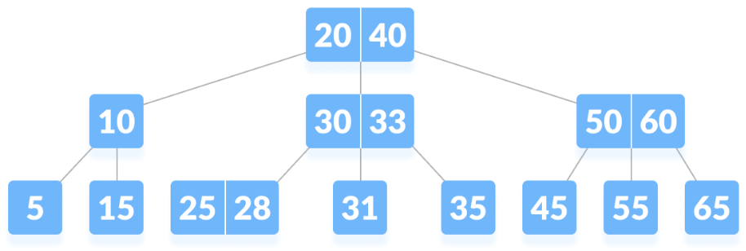
Historia
Creado por Rudolf Bayer y Edward M. McCreight en 1970 mientras ambos trabajaban en los Boeing Research Labs. Publicado por primera vez en el primer volumen de la revista Acta Informatica.Es una de las estructuras de datos más usadas hoy en día para el almacenamiento de datos.

Slide 3
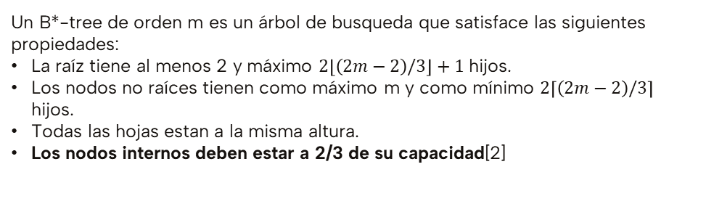
Definición formal
B-tree
Un árbol T pertenece a la clase T(k, h) de los B-tree si T está vacío (h = 0) o si cumple las siguientes propiedades:
Cada camino desde la raíz a las hojas tiene un tamaño h.
Cada nodo except la raíz y las hojas tiene al menos k + 1 hijos. La raíz es una hoja o tiene al menos 2 hijos.
Cada nodo tiene como máximo 2k + 2 hijos. [1]
B*-tree
Un B*-tree de orden m es un árbol de busqueda que satisface las siguientes propiedades:
La raíz tiene al menos 2 y máximo $2\left\lfloor \left(2m−2\right)/3\right\rfloor +1$ hijos.
Los nodos no raíces tienen como máximo m y como mínimo $2\left\lceil \left(2m−2\right)/3\right\rceil$ hijos.
Todas las hojas estan a la misma altura.
Los nodos internos deben estar a 2/3 de su capacidad[2]
[1] Bayer, R., & McCreight, E. M. (1972). Organization and maintenance of large ordered indices. Acta Informatica, 1(3). https://doi.org/10.1145/1734663.1734671

Slide 4
Algoritmo para inserción
Si se va a inserter en un nodo lleno:
Si es el nodo del extremo derecho:
Si el hermano Izquierdo tiene espacio:
Rotar claves a la izquierda para permitir inserción
Sino:
Realizar Algoritmo de división con hermano izquierdo
Si es el nodo del extremo Izquierdo:
Si el hermano Derecho tiene espacio:
Rotar claves a la derecha para permitir inserción
Sino:
Realizar algoritmo de división con hermano derecho
Si es el nodo intermedio:
Si el hermano Izquierdo tiene espacio:
Rotar claves a la izquierda para permitir inserción
Si el hermano Derecho tiene espacio:
Rotar claves a la derecha para permitir inserción
Si el hermano Izquierdo y Derecho estan llenos:
Realizar algoritmo de division con hermano derecho [2]

Slide 5
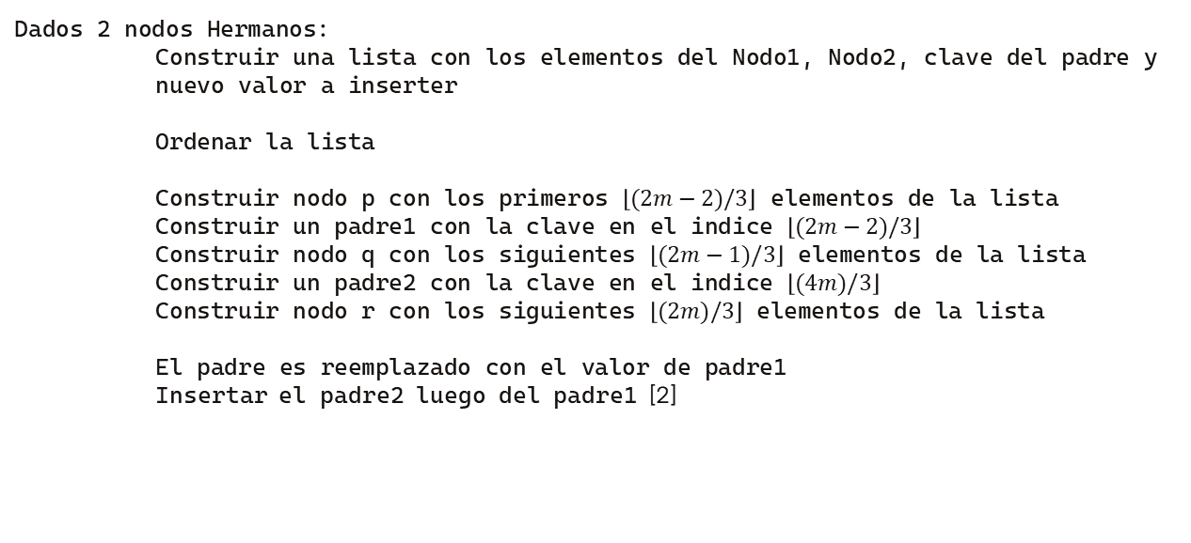
División 2-3
Dados 2 nodos Hermanos:
Construir una lista con los elementos del Nodo1, Nodo2, clave del padre y nuevo valor a inserter
Ordenar la lista
Construir nodo p con los primeros $\left\lfloor (2m−2)/3\right\rfloor$ elementos de la lista
Construir un padre1 con la clave en el indice $\left\lfloor (2m−2)/3\right\rfloor$
Construir nodo q con los siguientes $\left\lfloor (2m−1)/3\right\rfloor$ elementos de la lista
Construir un padre2 con la clave en el indice $\left\lfloor (4m)/3\right\rfloor$
Construir nodo r con los siguientes $\left\lfloor (2m)/3\right\rfloor$ elementos de la lista
El padre es reemplazado con el valor de padre1
Insertar el padre2 luego del padre1 [2]
[2] Stapleton, M. S. (2007). CSCI 311 - Program Two on B Star Trees. California State University, Chico. Recuperado 31 de marzo de 2024, de https://www.ecst.csuchico.edu/~mjstapleton/courses/Fall2007CSCI311/ProgTwo_Bstar.htm

Slide 6
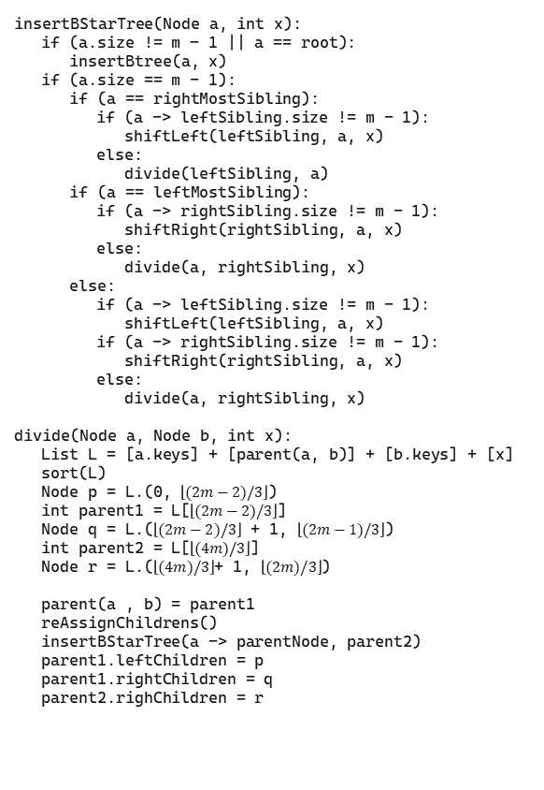
insertBStarTree(Node a, int x):
if (a.size != m – 1 || a == root):
insertBtree(a, x)
if (a.size == m - 1):
if (a == rightMostSibling):
if (a -> leftSibling.size != m - 1):
shiftLeft(leftSibling, a, x)
else:
divide(leftSibling, a)
if (a == leftMostSibling):
if (a -> rightSibling.size != m - 1):
shiftRight(rightSibling, a, x)
else:
divide(a, rightSibling, x)
else:
if (a -> leftSibling.size != m - 1):
shiftLeft(leftSibling, a, x)
if (a -> rightSibling.size != m - 1):
shiftRight(rightSibling, a, x)
else:
divide(a, rightSibling, x)
divide(Node a, Node b, int x):
List L = [a.keys] + [parent(a, b)] + [b.keys] + [x]
sort(L)
Node p = L.(0, $\left\lfloor (2m−2)/3\right\rfloor$)
int parent1 = L[$\left\lfloor (2m−2)/3\right\rfloor$]
Node q = L.($\left\lfloor (2m−2)/3\right\rfloor$ + 1, $\left\lfloor (2m−1)/3\right\rfloor$)
int parent2 = L[$\left\lfloor (4m)/3\right\rfloor$]
Node r = L.($\left\lfloor (4m)/3\right\rfloor$+ 1, $\left\lfloor (2m)/3\right\rfloor$)
parent(a , b) = parent1
reAssignChildrens()
insertBStarTree(a -> parentNode, parent2)
parent1.leftChildren = p
parent1.rightChildren = q
parent2.righChildren = r
Insertando los siguientes elementos en un B*-Tree de orden m = 5:
50
30
70
20
40
60
80
10
25
35
45
55
65
75
85

Slide 7
insertBStarTree(Node a, int x):
if (a.size != m – 1 || a == root):
insertBtree(a, x)
if (a.size == m - 1):
if (a == rightMostSibling):
if (a -> leftSibling.size != m - 1):
shiftLeft(leftSibling, a, x)
else:
divide(leftSibling, a)
if (a == leftMostSibling):
if (a -> rightSibling.size != m - 1):
shiftRight(rightSibling, a, x)
else:
divide(a, rightSibling, x)
else:
if (a -> leftSibling.size != m - 1):
shiftLeft(leftSibling, a, x)
if (a -> rightSibling.size != m - 1):
shiftRight(rightSibling, a, x)
else:
divide(a, rightSibling, x)
divide(Node a, Node b, int x):
List L = [a.keys] + [parent(a, b)] + [b.keys] + [x]
sort(L)
Node p = L.(0, $\left\lfloor (2m−2)/3\right\rfloor$)
int parent1 = L[$\left\lfloor (2m−2)/3\right\rfloor$]
Node q = L.($\left\lfloor (2m−2)/3\right\rfloor$ + 1, $\left\lfloor (2m−1)/3\right\rfloor$)
int parent2 = L[$\left\lfloor (4m)/3\right\rfloor$]
Node r = L.($\left\lfloor (4m)/3\right\rfloor$+ 1, $\left\lfloor (2m)/3\right\rfloor$)
parent(a , b) = parent1
reAssignChildrens()
insertBStarTree(a -> parentNode, parent2)
parent1.leftChildren = p
parent1.rightChildren = q
parent2.righChildren = r
Insertando los siguientes elementos en un B*-Tree de orden m = 5:
40
60
80
10
25
35
45
55
65
75
85
20
30
50
70

Slide 8
insertBStarTree(Node a, int x):
if (a.size != m – 1 || a == root):
insertBtree(a, x)
if (a.size == m - 1):
if (a == rightMostSibling):
if (a -> leftSibling.size != m - 1):
shiftLeft(leftSibling, a, x)
else:
divide(leftSibling, a)
if (a == leftMostSibling):
if (a -> rightSibling.size != m - 1):
shiftRight(rightSibling, a, x)
else:
divide(a, rightSibling, x)
else:
if (a -> leftSibling.size != m - 1):
shiftLeft(leftSibling, a, x)
if (a -> rightSibling.size != m - 1):
shiftRight(rightSibling, a, x)
else:
divide(a, rightSibling, x)
divide(Node a, Node b, int x):
List L = [a.keys] + [parent(a, b)] + [b.keys] + [x]
sort(L)
Node p = L.(0, $\left\lfloor (2m−2)/3\right\rfloor$)
int parent1 = L[$\left\lfloor (2m−2)/3\right\rfloor$]
Node q = L.($\left\lfloor (2m−2)/3\right\rfloor$ + 1, $\left\lfloor (2m−1)/3\right\rfloor$)
int parent2 = L[$\left\lfloor (4m)/3\right\rfloor$]
Node r = L.($\left\lfloor (4m)/3\right\rfloor$+ 1, $\left\lfloor (2m)/3\right\rfloor$)
parent(a , b) = parent1
reAssignChildrens()
insertBStarTree(a -> parentNode, parent2)
parent1.leftChildren = p
parent1.rightChildren = q
parent2.righChildren = r
Insertando los siguientes elementos en un B*-Tree de orden m = 5:
60
80
10
25
35
45
55
65
75
85
40
20
30
50
70

Slide 9
insertBStarTree(Node a, int x):
if (a.size != m – 1 || a == root):
insertBtree(a, x)
if (a.size == m - 1):
if (a == rightMostSibling):
if (a -> leftSibling.size != m - 1):
shiftLeft(leftSibling, a, x)
else:
divide(leftSibling, a)
if (a == leftMostSibling):
if (a -> rightSibling.size != m - 1):
shiftRight(rightSibling, a, x)
else:
divide(a, rightSibling, x)
else:
if (a -> leftSibling.size != m - 1):
shiftLeft(leftSibling, a, x)
if (a -> rightSibling.size != m - 1):
shiftRight(rightSibling, a, x)
else:
divide(a, rightSibling, x)
divide(Node a, Node b, int x):
List L = [a.keys] + [parent(a, b)] + [b.keys] + [x]
sort(L)
Node p = L.(0, $\left\lfloor (2m−2)/3\right\rfloor$)
int parent1 = L[$\left\lfloor (2m−2)/3\right\rfloor$]
Node q = L.($\left\lfloor (2m−2)/3\right\rfloor$ + 1, $\left\lfloor (2m−1)/3\right\rfloor$)
int parent2 = L[$\left\lfloor (4m)/3\right\rfloor$]
Node r = L.($\left\lfloor (4m)/3\right\rfloor$+ 1, $\left\lfloor (2m)/3\right\rfloor$)
parent(a , b) = parent1
reAssignChildrens()
insertBStarTree(a -> parentNode, parent2)
parent1.leftChildren = p
parent1.rightChildren = q
parent2.righChildren = r
Insertando los siguientes elementos en un B*-Tree de orden m = 5:
35
45
55
65
75
85
40
10
20
25
30
50
60
70
80

Slide 10
insertBStarTree(Node a, int x):
if (a.size != m – 1 || a == root):
insertBtree(a, x)
if (a.size == m - 1):
if (a == rightMostSibling):
if (a -> leftSibling.size != m - 1):
shiftLeft(leftSibling, a, x)
else:
divide(leftSibling, a)
if (a == leftMostSibling):
if (a -> rightSibling.size != m - 1):
shiftRight(rightSibling, a, x)
else:
divide(a, rightSibling, x)
else:
if (a -> leftSibling.size != m - 1):
shiftLeft(leftSibling, a, x)
if (a -> rightSibling.size != m - 1):
shiftRight(rightSibling, a, x)
else:
divide(a, rightSibling, x)
divide(Node a, Node b, int x):
List L = [a.keys] + [parent(a, b)] + [b.keys] + [x]
sort(L)
Node p = L.(0, $\left\lfloor (2m−2)/3\right\rfloor$)
int parent1 = L[$\left\lfloor (2m−2)/3\right\rfloor$]
Node q = L.($\left\lfloor (2m−2)/3\right\rfloor$ + 1, $\left\lfloor (2m−1)/3\right\rfloor$)
int parent2 = L[$\left\lfloor (4m)/3\right\rfloor$]
Node r = L.($\left\lfloor (4m)/3\right\rfloor$+ 1, $\left\lfloor (2m)/3\right\rfloor$)
parent(a , b) = parent1
reAssignChildrens()
insertBStarTree(a -> parentNode, parent2)
parent1.leftChildren = p
parent1.rightChildren = q
parent2.righChildren = r
Insertando los siguientes elementos en un B*-Tree de orden m = 5:
35
45
55
65
75
85
40
10
20
25
30
50
60
70
80

Slide 11
insertBStarTree(Node a, int x):
if (a.size != m – 1 || a == root):
insertBtree(a, x)
if (a.size == m - 1):
if (a == rightMostSibling):
if (a -> leftSibling.size != m - 1):
shiftLeft(leftSibling, a, x)
else:
divide(leftSibling, a)
if (a == leftMostSibling):
if (a -> rightSibling.size != m - 1):
shiftRight(rightSibling, a, x)
else:
divide(a, rightSibling, x)
else:
if (a -> leftSibling.size != m - 1):
shiftLeft(leftSibling, a, x)
if (a -> rightSibling.size != m - 1):
shiftRight(rightSibling, a, x)
else:
divide(a, rightSibling, x)
divide(Node a, Node b, int x):
List L = [a.keys] + [parent(a, b)] + [b.keys] + [x]
sort(L)
Node p = L.(0, $\left\lfloor (2m−2)/3\right\rfloor$)
int parent1 = L[$\left\lfloor (2m−2)/3\right\rfloor$]
Node q = L.($\left\lfloor (2m−2)/3\right\rfloor$ + 1, $\left\lfloor (2m−1)/3\right\rfloor$)
int parent2 = L[$\left\lfloor (4m)/3\right\rfloor$]
Node r = L.($\left\lfloor (4m)/3\right\rfloor$+ 1, $\left\lfloor (2m)/3\right\rfloor$)
parent(a , b) = parent1
reAssignChildrens()
insertBStarTree(a -> parentNode, parent2)
parent1.leftChildren = p
parent1.rightChildren = q
parent2.righChildren = r
Insertando los siguientes elementos en un B*-Tree de orden m = 5:
45
55
65
75
85
40
10
20
25
30
50
60
70
80
10
20
25
30
40
35
50
60
70
80

Slide 12
insertBStarTree(Node a, int x):
if (a.size != m – 1 || a == root):
insertBtree(a, x)
if (a.size == m - 1):
if (a == rightMostSibling):
if (a -> leftSibling.size != m - 1):
shiftLeft(leftSibling, a, x)
else:
divide(leftSibling, a)
if (a == leftMostSibling):
if (a -> rightSibling.size != m - 1):
shiftRight(rightSibling, a, x)
else:
divide(a, rightSibling, x)
else:
if (a -> leftSibling.size != m - 1):
shiftLeft(leftSibling, a, x)
if (a -> rightSibling.size != m - 1):
shiftRight(rightSibling, a, x)
else:
divide(a, rightSibling, x)
divide(Node a, Node b, int x):
List L = [a.keys] + [parent(a, b)] + [b.keys] + [x]
sort(L)
Node p = L.(0, $\left\lfloor (2m−2)/3\right\rfloor$)
int parent1 = L[$\left\lfloor (2m−2)/3\right\rfloor$]
Node q = L.($\left\lfloor (2m−2)/3\right\rfloor$ + 1, $\left\lfloor (2m−1)/3\right\rfloor$)
int parent2 = L[$\left\lfloor (4m)/3\right\rfloor$]
Node r = L.($\left\lfloor (4m)/3\right\rfloor$+ 1, $\left\lfloor (2m)/3\right\rfloor$)
parent(a , b) = parent1
reAssignChildrens()
insertBStarTree(a -> parentNode, parent2)
parent1.leftChildren = p
parent1.rightChildren = q
parent2.righChildren = r
Insertando los siguientes elementos en un B*-Tree de orden m = 5:
45
55
65
75
85
40
10
20
25
30
50
60
70
80
p
10
20
25
30
35
40
50
60
70
80

Slide 13
insertBStarTree(Node a, int x):
if (a.size != m – 1 || a == root):
insertBtree(a, x)
if (a.size == m - 1):
if (a == rightMostSibling):
if (a -> leftSibling.size != m - 1):
shiftLeft(leftSibling, a, x)
else:
divide(leftSibling, a)
if (a == leftMostSibling):
if (a -> rightSibling.size != m - 1):
shiftRight(rightSibling, a, x)
else:
divide(a, rightSibling, x)
else:
if (a -> leftSibling.size != m - 1):
shiftLeft(leftSibling, a, x)
if (a -> rightSibling.size != m - 1):
shiftRight(rightSibling, a, x)
else:
divide(a, rightSibling, x)
divide(Node a, Node b, int x):
List L = [a.keys] + [parent(a, b)] + [b.keys] + [x]
sort(L)
Node p = L.(0, $\left\lfloor (2m−2)/3\right\rfloor$)
int parent1 = L[$\left\lfloor (2m−2)/3\right\rfloor$]
Node q = L.($\left\lfloor (2m−2)/3\right\rfloor$ + 1, $\left\lfloor (2m−1)/3\right\rfloor$)
int parent2 = L[$\left\lfloor (4m)/3\right\rfloor$]
Node r = L.($\left\lfloor (4m)/3\right\rfloor$+ 1, $\left\lfloor (2m)/3\right\rfloor$)
parent(a , b) = parent1
reAssignChildrens()
insertBStarTree(a -> parentNode, parent2)
parent1.leftChildren = p
parent1.rightChildren = q
parent2.righChildren = r
Insertando los siguientes elementos en un B*-Tree de orden m = 5:
45
55
65
75
85
40
10
20
25
30
50
60
70
80
p
parent1
10
20
25
30
35
40
50
60
70
80

Slide 14
insertBStarTree(Node a, int x):
if (a.size != m – 1 || a == root):
insertBtree(a, x)
if (a.size == m - 1):
if (a == rightMostSibling):
if (a -> leftSibling.size != m - 1):
shiftLeft(leftSibling, a, x)
else:
divide(leftSibling, a)
if (a == leftMostSibling):
if (a -> rightSibling.size != m - 1):
shiftRight(rightSibling, a, x)
else:
divide(a, rightSibling, x)
else:
if (a -> leftSibling.size != m - 1):
shiftLeft(leftSibling, a, x)
if (a -> rightSibling.size != m - 1):
shiftRight(rightSibling, a, x)
else:
divide(a, rightSibling, x)
divide(Node a, Node b, int x):
List L = [a.keys] + [parent(a, b)] + [b.keys] + [x]
sort(L)
Node p = L.(0, $\left\lfloor (2m−2)/3\right\rfloor$)
int parent1 = L[$\left\lfloor (2m−2)/3\right\rfloor$]
Node q = L.($\left\lfloor (2m−2)/3\right\rfloor$ + 1, $\left\lfloor (2m−1)/3\right\rfloor$)
int parent2 = L[$\left\lfloor (4m)/3\right\rfloor$]
Node r = L.($\left\lfloor (4m)/3\right\rfloor$+ 1, $\left\lfloor (2m)/3\right\rfloor$)
parent(a , b) = parent1
reAssignChildrens()
insertBStarTree(a -> parentNode, parent2)
parent1.leftChildren = p
parent1.rightChildren = q
parent2.righChildren = r
Insertando los siguientes elementos en un B*-Tree de orden m = 5:
45
55
65
75
85
40
10
20
25
30
50
60
70
80
p
parent1
q
10
20
25
30
35
40
50
60
70
80

Slide 15
insertBStarTree(Node a, int x):
if (a.size != m – 1 || a == root):
insertBtree(a, x)
if (a.size == m - 1):
if (a == rightMostSibling):
if (a -> leftSibling.size != m - 1):
shiftLeft(leftSibling, a, x)
else:
divide(leftSibling, a)
if (a == leftMostSibling):
if (a -> rightSibling.size != m - 1):
shiftRight(rightSibling, a, x)
else:
divide(a, rightSibling, x)
else:
if (a -> leftSibling.size != m - 1):
shiftLeft(leftSibling, a, x)
if (a -> rightSibling.size != m - 1):
shiftRight(rightSibling, a, x)
else:
divide(a, rightSibling, x)
divide(Node a, Node b, int x):
List L = [a.keys] + [parent(a, b)] + [b.keys] + [x]
sort(L)
Node p = L.(0, $\left\lfloor (2m−2)/3\right\rfloor$)
int parent1 = L[$\left\lfloor (2m−2)/3\right\rfloor$]
Node q = L.($\left\lfloor (2m−2)/3\right\rfloor$ + 1, $\left\lfloor (2m−1)/3\right\rfloor$)
int parent2 = L[$\left\lfloor (4m)/3\right\rfloor$]
Node r = L.($\left\lfloor (4m)/3\right\rfloor$+ 1, $\left\lfloor (2m)/3\right\rfloor$)
parent(a , b) = parent1
reAssignChildrens()
insertBStarTree(a -> parentNode, parent2)
parent1.leftChildren = p
parent1.rightChildren = q
parent2.righChildren = r
Insertando los siguientes elementos en un B*-Tree de orden m = 5:
45
55
65
75
85
40
10
20
25
30
50
60
70
80
p
parent1
q
parent2
10
20
25
30
35
40
50
60
70
80

Slide 16
insertBStarTree(Node a, int x):
if (a.size != m – 1 || a == root):
insertBtree(a, x)
if (a.size == m - 1):
if (a == rightMostSibling):
if (a -> leftSibling.size != m - 1):
shiftLeft(leftSibling, a, x)
else:
divide(leftSibling, a)
if (a == leftMostSibling):
if (a -> rightSibling.size != m - 1):
shiftRight(rightSibling, a, x)
else:
divide(a, rightSibling, x)
else:
if (a -> leftSibling.size != m - 1):
shiftLeft(leftSibling, a, x)
if (a -> rightSibling.size != m - 1):
shiftRight(rightSibling, a, x)
else:
divide(a, rightSibling, x)
divide(Node a, Node b, int x):
List L = [a.keys] + [parent(a, b)] + [b.keys] + [x]
sort(L)
Node p = L.(0, $\left\lfloor (2m−2)/3\right\rfloor$)
int parent1 = L[$\left\lfloor (2m−2)/3\right\rfloor$]
Node q = L.($\left\lfloor (2m−2)/3\right\rfloor$ + 1, $\left\lfloor (2m−1)/3\right\rfloor$)
int parent2 = L[$\left\lfloor (4m)/3\right\rfloor$]
Node r = L.($\left\lfloor (4m)/3\right\rfloor$+ 1, $\left\lfloor (2m)/3\right\rfloor$)
parent(a , b) = parent1
reAssignChildrens()
insertBStarTree(a -> parentNode, parent2)
parent1.leftChildren = p
parent1.rightChildren = q
parent2.righChildren = r
Insertando los siguientes elementos en un B*-Tree de orden m = 5:
45
55
65
75
85
40
10
20
25
30
50
60
70
80
p
parent1
q
parent2
10
20
25
30
35
40
50
r
60
70
80

Slide 17
insertBStarTree(Node a, int x):
if (a.size != m – 1 || a == root):
insertBtree(a, x)
if (a.size == m - 1):
if (a == rightMostSibling):
if (a -> leftSibling.size != m - 1):
shiftLeft(leftSibling, a, x)
else:
divide(leftSibling, a)
if (a == leftMostSibling):
if (a -> rightSibling.size != m - 1):
shiftRight(rightSibling, a, x)
else:
divide(a, rightSibling, x)
else:
if (a -> leftSibling.size != m - 1):
shiftLeft(leftSibling, a, x)
if (a -> rightSibling.size != m - 1):
shiftRight(rightSibling, a, x)
else:
divide(a, rightSibling, x)
divide(Node a, Node b, int x):
List L = [a.keys] + [parent(a, b)] + [b.keys] + [x]
sort(L)
Node p = L.(0, $\left\lfloor (2m−2)/3\right\rfloor$)
int parent1 = L[$\left\lfloor (2m−2)/3\right\rfloor$]
Node q = L.($\left\lfloor (2m−2)/3\right\rfloor$ + 1, $\left\lfloor (2m−1)/3\right\rfloor$)
int parent2 = L[$\left\lfloor (4m)/3\right\rfloor$]
Node r = L.($\left\lfloor (4m)/3\right\rfloor$+ 1, $\left\lfloor (2m)/3\right\rfloor$)
parent(a , b) = parent1
reAssignChildrens()
insertBStarTree(a -> parentNode, parent2)
parent1.leftChildren = p
parent1.rightChildren = q
parent2.righChildren = r
Insertando los siguientes elementos en un B*-Tree de orden m = 5:
45
55
65
75
85
25
10
20
25
30
50
60
70
80
p
q
parent2
10
20
30
35
40
50
r
60
70
80

Slide 18
insertBStarTree(Node a, int x):
if (a.size != m – 1 || a == root):
insertBtree(a, x)
if (a.size == m - 1):
if (a == rightMostSibling):
if (a -> leftSibling.size != m - 1):
shiftLeft(leftSibling, a, x)
else:
divide(leftSibling, a)
if (a == leftMostSibling):
if (a -> rightSibling.size != m - 1):
shiftRight(rightSibling, a, x)
else:
divide(a, rightSibling, x)
else:
if (a -> leftSibling.size != m - 1):
shiftLeft(leftSibling, a, x)
if (a -> rightSibling.size != m - 1):
shiftRight(rightSibling, a, x)
else:
divide(a, rightSibling, x)
divide(Node a, Node b, int x):
List L = [a.keys] + [parent(a, b)] + [b.keys] + [x]
sort(L)
Node p = L.(0, $\left\lfloor (2m−2)/3\right\rfloor$)
int parent1 = L[$\left\lfloor (2m−2)/3\right\rfloor$]
Node q = L.($\left\lfloor (2m−2)/3\right\rfloor$ + 1, $\left\lfloor (2m−1)/3\right\rfloor$)
int parent2 = L[$\left\lfloor (4m)/3\right\rfloor$]
Node r = L.($\left\lfloor (4m)/3\right\rfloor$+ 1, $\left\lfloor (2m)/3\right\rfloor$)
parent(a , b) = parent1
reAssignChildrens()
insertBStarTree(a -> parentNode, parent2)
parent1.leftChildren = p
parent1.rightChildren = q
parent2.righChildren = r
Insertando los siguientes elementos en un B*-Tree de orden m = 5:
45
55
65
75
85
25
10
20
25
30
50
60
70
80
p
q
parent2
10
20
30
35
40
50
r
60
70
80

Slide 19
insertBStarTree(Node a, int x):
if (a.size != m – 1 || a == root):
insertBtree(a, x)
if (a.size == m - 1):
if (a == rightMostSibling):
if (a -> leftSibling.size != m - 1):
shiftLeft(leftSibling, a, x)
else:
divide(leftSibling, a)
if (a == leftMostSibling):
if (a -> rightSibling.size != m - 1):
shiftRight(rightSibling, a, x)
else:
divide(a, rightSibling, x)
else:
if (a -> leftSibling.size != m - 1):
shiftLeft(leftSibling, a, x)
if (a -> rightSibling.size != m - 1):
shiftRight(rightSibling, a, x)
else:
divide(a, rightSibling, x)
divide(Node a, Node b, int x):
List L = [a.keys] + [parent(a, b)] + [b.keys] + [x]
sort(L)
Node p = L.(0, $\left\lfloor (2m−2)/3\right\rfloor$)
int parent1 = L[$\left\lfloor (2m−2)/3\right\rfloor$]
Node q = L.($\left\lfloor (2m−2)/3\right\rfloor$ + 1, $\left\lfloor (2m−1)/3\right\rfloor$)
int parent2 = L[$\left\lfloor (4m)/3\right\rfloor$]
Node r = L.($\left\lfloor (4m)/3\right\rfloor$+ 1, $\left\lfloor (2m)/3\right\rfloor$)
parent(a , b) = parent1
reAssignChildrens()
insertBStarTree(a -> parentNode, parent2)
parent1.leftChildren = p
parent1.rightChildren = q
parent2.righChildren = r
Insertando los siguientes elementos en un B*-Tree de orden m = 5:
45
55
65
75
85
25
10
20
25
30
50
60
70
80
p
q
parent2
10
20
30
35
40
50
r
60
70
80

Slide 20
insertBStarTree(Node a, int x):
if (a.size != m – 1 || a == root):
insertBtree(a, x)
if (a.size == m - 1):
if (a == rightMostSibling):
if (a -> leftSibling.size != m - 1):
shiftLeft(leftSibling, a, x)
else:
divide(leftSibling, a)
if (a == leftMostSibling):
if (a -> rightSibling.size != m - 1):
shiftRight(rightSibling, a, x)
else:
divide(a, rightSibling, x)
else:
if (a -> leftSibling.size != m - 1):
shiftLeft(leftSibling, a, x)
if (a -> rightSibling.size != m - 1):
shiftRight(rightSibling, a, x)
else:
divide(a, rightSibling, x)
divide(Node a, Node b, int x):
List L = [a.keys] + [parent(a, b)] + [b.keys] + [x]
sort(L)
Node p = L.(0, $\left\lfloor (2m−2)/3\right\rfloor$)
int parent1 = L[$\left\lfloor (2m−2)/3\right\rfloor$]
Node q = L.($\left\lfloor (2m−2)/3\right\rfloor$ + 1, $\left\lfloor (2m−1)/3\right\rfloor$)
int parent2 = L[$\left\lfloor (4m)/3\right\rfloor$]
Node r = L.($\left\lfloor (4m)/3\right\rfloor$+ 1, $\left\lfloor (2m)/3\right\rfloor$)
parent(a , b) = parent1
reAssignChildrens()
insertBStarTree(a -> parentNode, parent2)
parent1.leftChildren = p
parent1.rightChildren = q
parent2.righChildren = r
Insertando los siguientes elementos en un B*-Tree de orden m = 5:
45
55
65
75
85
25
50
10
20
25
30
50
60
70
80
p
q
10
20
30
35
40
r
60
70
80

Slide 21
insertBStarTree(Node a, int x):
if (a.size != m – 1 || a == root):
insertBtree(a, x)
if (a.size == m - 1):
if (a == rightMostSibling):
if (a -> leftSibling.size != m - 1):
shiftLeft(leftSibling, a, x)
else:
divide(leftSibling, a)
if (a == leftMostSibling):
if (a -> rightSibling.size != m - 1):
shiftRight(rightSibling, a, x)
else:
divide(a, rightSibling, x)
else:
if (a -> leftSibling.size != m - 1):
shiftLeft(leftSibling, a, x)
if (a -> rightSibling.size != m - 1):
shiftRight(rightSibling, a, x)
else:
divide(a, rightSibling, x)
divide(Node a, Node b, int x):
List L = [a.keys] + [parent(a, b)] + [b.keys] + [x]
sort(L)
Node p = L.(0, $\left\lfloor (2m−2)/3\right\rfloor$)
int parent1 = L[$\left\lfloor (2m−2)/3\right\rfloor$]
Node q = L.($\left\lfloor (2m−2)/3\right\rfloor$ + 1, $\left\lfloor (2m−1)/3\right\rfloor$)
int parent2 = L[$\left\lfloor (4m)/3\right\rfloor$]
Node r = L.($\left\lfloor (4m)/3\right\rfloor$+ 1, $\left\lfloor (2m)/3\right\rfloor$)
parent(a , b) = parent1
reAssignChildrens()
insertBStarTree(a -> parentNode, parent2)
parent1.leftChildren = p
parent1.rightChildren = q
parent2.righChildren = r
Insertando los siguientes elementos en un B*-Tree de orden m = 5:
45
55
65
75
85
25
50
10
20
30
35
40
60
70
80

Slide 22
insertBStarTree(Node a, int x):
if (a.size != m – 1 || a == root):
insertBtree(a, x)
if (a.size == m - 1):
if (a == rightMostSibling):
if (a -> leftSibling.size != m - 1):
shiftLeft(leftSibling, a, x)
else:
divide(leftSibling, a)
if (a == leftMostSibling):
if (a -> rightSibling.size != m - 1):
shiftRight(rightSibling, a, x)
else:
divide(a, rightSibling, x)
else:
if (a -> leftSibling.size != m - 1):
shiftLeft(leftSibling, a, x)
if (a -> rightSibling.size != m - 1):
shiftRight(rightSibling, a, x)
else:
divide(a, rightSibling, x)
divide(Node a, Node b, int x):
List L = [a.keys] + [parent(a, b)] + [b.keys] + [x]
sort(L)
Node p = L.(0, $\left\lfloor (2m−2)/3\right\rfloor$)
int parent1 = L[$\left\lfloor (2m−2)/3\right\rfloor$]
Node q = L.($\left\lfloor (2m−2)/3\right\rfloor$ + 1, $\left\lfloor (2m−1)/3\right\rfloor$)
int parent2 = L[$\left\lfloor (4m)/3\right\rfloor$]
Node r = L.($\left\lfloor (4m)/3\right\rfloor$+ 1, $\left\lfloor (2m)/3\right\rfloor$)
parent(a , b) = parent1
reAssignChildrens()
insertBStarTree(a -> parentNode, parent2)
parent1.leftChildren = p
parent1.rightChildren = q
parent2.righChildren = r
Insertando los siguientes elementos en un B*-Tree de orden m = 5:
45
55
65
75
85
25
50
10
20
30
35
40
60
70
80

Slide 23
insertBStarTree(Node a, int x):
if (a.size != m – 1 || a == root):
insertBtree(a, x)
if (a.size == m - 1):
if (a == rightMostSibling):
if (a -> leftSibling.size != m - 1):
shiftLeft(leftSibling, a, x)
else:
divide(leftSibling, a)
if (a == leftMostSibling):
if (a -> rightSibling.size != m - 1):
shiftRight(rightSibling, a, x)
else:
divide(a, rightSibling, x)
else:
if (a -> leftSibling.size != m - 1):
shiftLeft(leftSibling, a, x)
if (a -> rightSibling.size != m - 1):
shiftRight(rightSibling, a, x)
else:
divide(a, rightSibling, x)
divide(Node a, Node b, int x):
List L = [a.keys] + [parent(a, b)] + [b.keys] + [x]
sort(L)
Node p = L.(0, $\left\lfloor (2m−2)/3\right\rfloor$)
int parent1 = L[$\left\lfloor (2m−2)/3\right\rfloor$]
Node q = L.($\left\lfloor (2m−2)/3\right\rfloor$ + 1, $\left\lfloor (2m−1)/3\right\rfloor$)
int parent2 = L[$\left\lfloor (4m)/3\right\rfloor$]
Node r = L.($\left\lfloor (4m)/3\right\rfloor$+ 1, $\left\lfloor (2m)/3\right\rfloor$)
parent(a , b) = parent1
reAssignChildrens()
insertBStarTree(a -> parentNode, parent2)
parent1.leftChildren = p
parent1.rightChildren = q
parent2.righChildren = r
Insertando los siguientes elementos en un B*-Tree de orden m = 5:
65
75
85
25
50
10
20
30
35
40
45
55
60
70
80

Slide 24
insertBStarTree(Node a, int x):
if (a.size != m – 1 || a == root):
insertBtree(a, x)
if (a.size == m - 1):
if (a == rightMostSibling):
if (a -> leftSibling.size != m - 1):
shiftLeft(leftSibling, a, x)
else:
divide(leftSibling, a)
if (a == leftMostSibling):
if (a -> rightSibling.size != m - 1):
shiftRight(rightSibling, a, x)
else:
divide(a, rightSibling, x)
else:
if (a -> leftSibling.size != m - 1):
shiftLeft(leftSibling, a, x)
if (a -> rightSibling.size != m - 1):
shiftRight(rightSibling, a, x)
else:
divide(a, rightSibling, x)
divide(Node a, Node b, int x):
List L = [a.keys] + [parent(a, b)] + [b.keys] + [x]
sort(L)
Node p = L.(0, $\left\lfloor (2m−2)/3\right\rfloor$)
int parent1 = L[$\left\lfloor (2m−2)/3\right\rfloor$]
Node q = L.($\left\lfloor (2m−2)/3\right\rfloor$ + 1, $\left\lfloor (2m−1)/3\right\rfloor$)
int parent2 = L[$\left\lfloor (4m)/3\right\rfloor$]
Node r = L.($\left\lfloor (4m)/3\right\rfloor$+ 1, $\left\lfloor (2m)/3\right\rfloor$)
parent(a , b) = parent1
reAssignChildrens()
insertBStarTree(a -> parentNode, parent2)
parent1.leftChildren = p
parent1.rightChildren = q
parent2.righChildren = r
Insertando los siguientes elementos en un B*-Tree de orden m = 5:
65
75
85
25
50
10
20
30
35
40
45
55
60
70
80

Slide 25
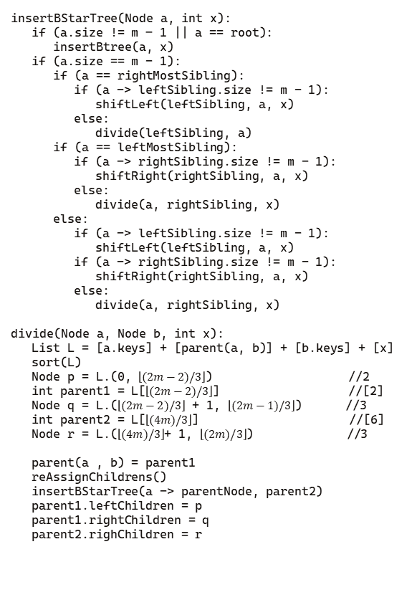
insertBStarTree(Node a, int x):
if (a.size != m – 1 || a == root):
insertBtree(a, x)
if (a.size == m - 1):
if (a == rightMostSibling):
if (a -> leftSibling.size != m - 1):
shiftLeft(leftSibling, a, x)
else:
divide(leftSibling, a)
if (a == leftMostSibling):
if (a -> rightSibling.size != m - 1):
shiftRight(rightSibling, a, x)
else:
divide(a, rightSibling, x)
else:
if (a -> leftSibling.size != m - 1):
shiftLeft(leftSibling, a, x)
if (a -> rightSibling.size != m - 1):
shiftRight(rightSibling, a, x)
else:
divide(a, rightSibling, x)
divide(Node a, Node b, int x):
List L = [a.keys] + [parent(a, b)] + [b.keys] + [x]
sort(L)
Node p = L.(0, $\left\lfloor (2m−2)/3\right\rfloor$) //2
int parent1 = L[$\left\lfloor (2m−2)/3\right\rfloor$] //[2]
Node q = L.($\left\lfloor (2m−2)/3\right\rfloor$ + 1, $\left\lfloor (2m−1)/3\right\rfloor$) //3
int parent2 = L[$\left\lfloor (4m)/3\right\rfloor$] //[6]
Node r = L.($\left\lfloor (4m)/3\right\rfloor$+ 1, $\left\lfloor (2m)/3\right\rfloor$) //3
parent(a , b) = parent1
reAssignChildrens()
insertBStarTree(a -> parentNode, parent2)
parent1.leftChildren = p
parent1.rightChildren = q
parent2.righChildren = r
Insertando los siguientes elementos en un B*-Tree de orden m = 5:
75
85
25
50
10
20
30
35
40
45
55
60
70
80
p
parent1
q
parent2
30
35
40
45
50
55
60
r
65
70
80

Slide 26
insertBStarTree(Node a, int x):
if (a.size != m – 1 || a == root):
insertBtree(a, x)
if (a.size == m - 1):
if (a == rightMostSibling):
if (a -> leftSibling.size != m - 1):
shiftLeft(leftSibling, a, x)
else:
divide(leftSibling, a)
if (a == leftMostSibling):
if (a -> rightSibling.size != m - 1):
shiftRight(rightSibling, a, x)
else:
divide(a, rightSibling, x)
else:
if (a -> leftSibling.size != m - 1):
shiftLeft(leftSibling, a, x)
if (a -> rightSibling.size != m - 1):
shiftRight(rightSibling, a, x)
else:
divide(a, rightSibling, x)
divide(Node a, Node b, int x):
List L = [a.keys] + [parent(a, b)] + [b.keys] + [x]
sort(L)
Node p = L.(0, $\left\lfloor (2m−2)/3\right\rfloor$) //2
int parent1 = L[$\left\lfloor (2m−2)/3\right\rfloor$] //[2]
Node q = L.($\left\lfloor (2m−2)/3\right\rfloor$ + 1, $\left\lfloor (2m−1)/3\right\rfloor$) //3
int parent2 = L[$\left\lfloor (4m)/3\right\rfloor$] //[6]
Node r = L.($\left\lfloor (4m)/3\right\rfloor$+ 1, $\left\lfloor (2m)/3\right\rfloor$) //3
parent(a , b) = parent1
reAssignChildrens()
insertBStarTree(a -> parentNode, parent2)
parent1.leftChildren = p
parent1.rightChildren = q
parent2.righChildren = r
Insertando los siguientes elementos en un B*-Tree de orden m = 5:
75
85
25
40
10
20
30
35
40
45
55
60
70
80
p
q
parent2
30
35
45
50
55
60
r
65
70
80

Slide 27
insertBStarTree(Node a, int x):
if (a.size != m – 1 || a == root):
insertBtree(a, x)
if (a.size == m - 1):
if (a == rightMostSibling):
if (a -> leftSibling.size != m - 1):
shiftLeft(leftSibling, a, x)
else:
divide(leftSibling, a)
if (a == leftMostSibling):
if (a -> rightSibling.size != m - 1):
shiftRight(rightSibling, a, x)
else:
divide(a, rightSibling, x)
else:
if (a -> leftSibling.size != m - 1):
shiftLeft(leftSibling, a, x)
if (a -> rightSibling.size != m - 1):
shiftRight(rightSibling, a, x)
else:
divide(a, rightSibling, x)
divide(Node a, Node b, int x):
List L = [a.keys] + [parent(a, b)] + [b.keys] + [x]
sort(L)
Node p = L.(0, $\left\lfloor (2m−2)/3\right\rfloor$) //2
int parent1 = L[$\left\lfloor (2m−2)/3\right\rfloor$] //[2]
Node q = L.($\left\lfloor (2m−2)/3\right\rfloor$ + 1, $\left\lfloor (2m−1)/3\right\rfloor$) //3
int parent2 = L[$\left\lfloor (4m)/3\right\rfloor$] //[6]
Node r = L.($\left\lfloor (4m)/3\right\rfloor$+ 1, $\left\lfloor (2m)/3\right\rfloor$) //3
parent(a , b) = parent1
reAssignChildrens()
insertBStarTree(a -> parentNode, parent2)
parent1.leftChildren = p
parent1.rightChildren = q
parent2.righChildren = r
Insertando los siguientes elementos en un B*-Tree de orden m = 5:
75
85
25
40
60
10
20
30
35
40
45
55
60
70
80
p
q
30
35
45
50
55
r
65
70
80

Slide 28
insertBStarTree(Node a, int x):
if (a.size != m – 1 || a == root):
insertBtree(a, x)
if (a.size == m - 1):
if (a == rightMostSibling):
if (a -> leftSibling.size != m - 1):
shiftLeft(leftSibling, a, x)
else:
divide(leftSibling, a)
if (a == leftMostSibling):
if (a -> rightSibling.size != m - 1):
shiftRight(rightSibling, a, x)
else:
divide(a, rightSibling, x)
else:
if (a -> leftSibling.size != m - 1):
shiftLeft(leftSibling, a, x)
if (a -> rightSibling.size != m - 1):
shiftRight(rightSibling, a, x)
else:
divide(a, rightSibling, x)
divide(Node a, Node b, int x):
List L = [a.keys] + [parent(a, b)] + [b.keys] + [x]
sort(L)
Node p = L.(0, $\left\lfloor (2m−2)/3\right\rfloor$) //2
int parent1 = L[$\left\lfloor (2m−2)/3\right\rfloor$] //[2]
Node q = L.($\left\lfloor (2m−2)/3\right\rfloor$ + 1, $\left\lfloor (2m−1)/3\right\rfloor$) //3
int parent2 = L[$\left\lfloor (4m)/3\right\rfloor$] //[6]
Node r = L.($\left\lfloor (4m)/3\right\rfloor$+ 1, $\left\lfloor (2m)/3\right\rfloor$) //3
parent(a , b) = parent1
reAssignChildrens()
insertBStarTree(a -> parentNode, parent2)
parent1.leftChildren = p
parent1.rightChildren = q
parent2.righChildren = r
Insertando los siguientes elementos en un B*-Tree de orden m = 5:
75
85
25
40
60
30
65
70
80
30
35
10
20
35
40
45
55
45
50
55
60
70
80

Slide 29
insertBStarTree(Node a, int x):
if (a.size != m – 1 || a == root):
insertBtree(a, x)
if (a.size == m - 1):
if (a == rightMostSibling):
if (a -> leftSibling.size != m - 1):
shiftLeft(leftSibling, a, x)
else:
divide(leftSibling, a)
if (a == leftMostSibling):
if (a -> rightSibling.size != m - 1):
shiftRight(rightSibling, a, x)
else:
divide(a, rightSibling, x)
else:
if (a -> leftSibling.size != m - 1):
shiftLeft(leftSibling, a, x)
if (a -> rightSibling.size != m - 1):
shiftRight(rightSibling, a, x)
else:
divide(a, rightSibling, x)
divide(Node a, Node b, int x):
List L = [a.keys] + [parent(a, b)] + [b.keys] + [x]
sort(L)
Node p = L.(0, $\left\lfloor (2m−2)/3\right\rfloor$) //2
int parent1 = L[$\left\lfloor (2m−2)/3\right\rfloor$] //[2]
Node q = L.($\left\lfloor (2m−2)/3\right\rfloor$ + 1, $\left\lfloor (2m−1)/3\right\rfloor$) //3
int parent2 = L[$\left\lfloor (4m)/3\right\rfloor$] //[6]
Node r = L.($\left\lfloor (4m)/3\right\rfloor$+ 1, $\left\lfloor (2m)/3\right\rfloor$) //3
parent(a , b) = parent1
reAssignChildrens()
insertBStarTree(a -> parentNode, parent2)
parent1.leftChildren = p
parent1.rightChildren = q
parent2.righChildren = r
Insertando los siguientes elementos en un B*-Tree de orden m = 5:
75
85
25
40
60
10
20
30
35
45
50
55
65
70
80

Slide 30
insertBStarTree(Node a, int x):
if (a.size != m – 1 || a == root):
insertBtree(a, x)
if (a.size == m - 1):
if (a == rightMostSibling):
if (a -> leftSibling.size != m - 1):
shiftLeft(leftSibling, a, x)
else:
divide(leftSibling, a)
if (a == leftMostSibling):
if (a -> rightSibling.size != m - 1):
shiftRight(rightSibling, a, x)
else:
divide(a, rightSibling, x)
else:
if (a -> leftSibling.size != m - 1):
shiftLeft(leftSibling, a, x)
if (a -> rightSibling.size != m - 1):
shiftRight(rightSibling, a, x)
else:
divide(a, rightSibling, x)
divide(Node a, Node b, int x):
List L = [a.keys] + [parent(a, b)] + [b.keys] + [x]
sort(L)
Node p = L.(0, $\left\lfloor (2m−2)/3\right\rfloor$) //2
int parent1 = L[$\left\lfloor (2m−2)/3\right\rfloor$] //[2]
Node q = L.($\left\lfloor (2m−2)/3\right\rfloor$ + 1, $\left\lfloor (2m−1)/3\right\rfloor$) //3
int parent2 = L[$\left\lfloor (4m)/3\right\rfloor$] //[6]
Node r = L.($\left\lfloor (4m)/3\right\rfloor$+ 1, $\left\lfloor (2m)/3\right\rfloor$) //3
parent(a , b) = parent1
reAssignChildrens()
insertBStarTree(a -> parentNode, parent2)
parent1.leftChildren = p
parent1.rightChildren = q
parent2.righChildren = r
Insertando los siguientes elementos en un B*-Tree de orden m = 5:
85
25
40
60
10
20
30
35
45
50
55
65
70
75
80

Slide 31
insertBStarTree(Node a, int x):
if (a.size != m – 1 || a == root):
insertBtree(a, x)
if (a.size == m - 1):
if (a == rightMostSibling):
if (a -> leftSibling.size != m - 1):
shiftLeft(leftSibling, a, x)
else:
divide(leftSibling, a)
if (a == leftMostSibling):
if (a -> rightSibling.size != m - 1):
shiftRight(rightSibling, a, x)
else:
divide(a, rightSibling, x)
else:
if (a -> leftSibling.size != m - 1):
shiftLeft(leftSibling, a, x)
if (a -> rightSibling.size != m - 1):
shiftRight(rightSibling, a, x)
else:
divide(a, rightSibling, x)
divide(Node a, Node b, int x):
List L = [a.keys] + [parent(a, b)] + [b.keys] + [x]
sort(L)
Node p = L.(0, $\left\lfloor (2m−2)/3\right\rfloor$) //2
int parent1 = L[$\left\lfloor (2m−2)/3\right\rfloor$] //[2]
Node q = L.($\left\lfloor (2m−2)/3\right\rfloor$ + 1, $\left\lfloor (2m−1)/3\right\rfloor$) //3
int parent2 = L[$\left\lfloor (4m)/3\right\rfloor$] //[6]
Node r = L.($\left\lfloor (4m)/3\right\rfloor$+ 1, $\left\lfloor (2m)/3\right\rfloor$) //3
parent(a , b) = parent1
reAssignChildrens()
insertBStarTree(a -> parentNode, parent2)
parent1.leftChildren = p
parent1.rightChildren = q
parent2.righChildren = r
Insertando los siguientes elementos en un B*-Tree de orden m = 5:
25
40
65
10
20
30
35
45
50
55
60
70
75
80
85

Slide 32
Transformar B-tree a B*-tree
Dado un B-tree
Recorrer el B-tree de derecha a izquierda: Si el nodo no esta a 2/3 de su capacidad:
Si la cantidad de claves a la Izquierda es mayor que las claves necesarias + 1
Rotar claves a la derecha hasta que el nodo este lleno
Sino
Tratar de optimizer sin romper la estructura

Slide 33

BTreeToBStarTree (Btree T):
For (a = nodos in T):
if (a.size < $\left\lfloor 2/3m\right\rfloor$ && a == root):
continue
else:
if (leftKeys > neededKeys + 1):
fillFromLeft(a)
else:
tryFilling(a)
Transformando el siguiente B-tree de orden m = 5, en un B*-tree
25
40
60
75
10
20
30
35
45
50
55
65
70
80
85

Slide 34
BTreeToBStarTree (Btree T):
For (a = nodos in T):
if (a.size < $\left\lfloor 2/3m\right\rfloor$ && a == root):
continue
else:
if (leftKeys > neededKeys + 1):
fillFromLeft(a)
else:
tryFilling(a)
Transformando el siguiente B-tree de orden m = 5, en un B*-tree
25
40
60
75
10
20
30
35
45
50
55
65
70
80
85

Slide 35
BTreeToBStarTree (Btree T):
For (a = nodos in T):
if (a.size < $\left\lfloor 2/3m\right\rfloor$ && a == root):
continue
else:
if (leftKeys > neededKeys + 1):
fillFromLeft(a)
else:
tryFilling(a)
Transformando el siguiente B-tree de orden m = 5, en un B*-tree
25
40
60
75
10
20
30
35
45
50
55
65
70
80
85

Slide 36
BTreeToBStarTree (Btree T):
For (a = nodos in T):
if (a.size < $\left\lfloor 2/3m\right\rfloor$ && a == root):
continue
else:
if (leftKeys > neededKeys + 1):
fillFromLeft(a)
else:
tryFilling(a)
Transformando el siguiente B-tree de orden m = 5, en un B*-tree
25
40
60
10
20
30
35
45
50
55
65
70
75
80
85

Slide 37
BTreeToBStarTree (Btree T):
For (a = nodos in T):
if (a.size < $\left\lfloor 2/3m\right\rfloor$ && a == root):
continue
else:
if (leftKeys > neededKeys + 1):
fillFromLeft(a)
else:
tryFilling(a)
Transformando el siguiente B-tree de orden m = 5, en un B*-tree
25
40
60
65
10
20
30
35
45
50
55
70
75
80
85

Slide 38
BTreeToBStarTree (Btree T):
For (a = nodos in T):
if (a.size < $\left\lfloor 2/3m\right\rfloor$ && a == root):
continue
else:
if (leftKeys > neededKeys + 1):
fillFromLeft(a)
else:
tryFilling(a)
Transformando el siguiente B-tree de orden m = 5, en un B*-tree
25
40
55
65
10
20
30
35
45
50
60
70
75
80
85

Slide 39
BTreeToBStarTree (Btree T):
For (a = nodos in T):
if (a.size < $\left\lfloor 2/3m\right\rfloor$ && a == root):
continue
else:
if (leftKeys > neededKeys + 1):
fillFromLeft(a)
else:
tryFilling(a)
Transformando el siguiente B-tree de orden m = 5, en un B*-tree
25
40
65
10
20
30
35
45
50
55
60
70
75
80
85

Slide 40
BTreeToBStarTree (Btree T):
For (a = nodos in T):
if (a.size < $\left\lfloor 2/3m\right\rfloor$ && a == root):
continue
else:
if (leftKeys > neededKeys + 1):
fillFromLeft(a)
else:
tryFilling(a)
Transformando el siguiente B-tree de orden m = 5, en un B*-tree
25
35
65
10
20
30
40
45
50
55
60
70
75
80
85

Slide 41
BTreeToBStarTree (Btree T):
For (a = nodos in T):
if (a.size < $\left\lfloor 2/3m\right\rfloor$ && a == root):
continue
else:
if (leftKeys > neededKeys + 1):
fillFromLeft(a)
else:
tryFilling(a)
Transformando el siguiente B-tree de orden m = 5, en un B*-tree
20
30
40
65
10
25
35
45
50
55
60
70
75
80
85

Slide 42
BTreeToBStarTree (Btree T):
For (a = nodos in T):
if (a.size < $\left\lfloor 2/3m\right\rfloor$ && a == root):
continue
else:
if (leftKeys > neededKeys + 1):
fillFromLeft(a)
else:
tryFilling(a)
Transformando el siguiente B-tree de orden m = 5, en un B*-tree
20
30
40
65
10
25
35
45
50
55
60
70
75
80
85

Slide 43
BTreeToBStarTree (Btree T):
For (a = nodos in T):
if (a.size < $\left\lfloor 2/3m\right\rfloor$ && a == root):
continue
else:
if (leftKeys > neededKeys + 1):
fillFromLeft(a)
else:
tryFilling(a)
Transformando el siguiente B-tree de orden m = 5, en un B*-tree
20
30
40
65
10
25
35
45
50
55
60
70
75
80
85

Slide 44
BTreeToBStarTree (Btree T):
For (a = nodos in T):
if (a.size < $\left\lfloor 2/3m\right\rfloor$ && a == root):
continue
else:
if (leftKeys > neededKeys + 1):
fillFromLeft(a)
else:
tryFilling(a)
Transformando el siguiente B-tree de orden m = 5, en un B*-tree
20
30
40
65
10
25
35
45
50
55
60
70
75
80
85

Slide 45
BTreeToBStarTree (Btree T):
For (a = nodos in T):
if (a.size < $\left\lfloor 2/3m\right\rfloor$ && a == root):
continue
else:
if (leftKeys > neededKeys + 1):
fillFromLeft(a)
else:
tryFilling(a)
Transformando el siguiente B-tree de orden m = 5, en un B*-tree
20
25
40
65
10
30
35
45
50
55
60
70
75
80
85

Slide 46
BTreeToBStarTree (Btree T):
For (a = nodos in T):
if (a.size < $\left\lfloor 2/3m\right\rfloor$ && a == root):
continue
else:
if (leftKeys > neededKeys + 1):
fillFromLeft(a)
else:
tryFilling(a)
Transformando el siguiente B-tree de orden m = 5, en un B*-tree
25
40
65
10
20
30
35
45
50
55
60
70
75
80
85

Slide 47
BTreeToBStarTree (Btree T):
For (a = nodos in T):
if (a.size < $\left\lfloor 2/3m\right\rfloor$ && a == root):
continue
else:
if (leftKeys > neededKeys + 1):
fillFromLeft(a)
else:
tryFilling(a)
Transformando el siguiente B-tree de orden m = 5, en un B*-tree
25
40
65
10
20
30
35
45
50
55
60
70
75
80
85

Slide 48
BTreeToBStarTree (Btree T):
For (a = nodos in T):
if (a.size < $\left\lfloor 2/3m\right\rfloor$ && a == root):
continue
else:
if (leftKeys > neededKeys + 1):
fillFromLeft(a)
else:
tryFilling(a)
Transformando el siguiente B-tree de orden m = 5, en un B*-tree
25
40
65
10
20
30
35
45
50
55
60
70
75
80
85
25
40
65
10
20
30
35
45
50
55
60
70
75
80
85

Slide 49
BTreeToBStarTree (Btree T):
For (a = nodos in T):
if (a.size < $\left\lfloor 2/3m\right\rfloor$ && a == root):
continue
else:
if (leftKeys > neededKeys + 1):
fillFromLeft(a)
else:
tryFilling(a)
Transformando el siguiente B-tree de orden m = 5, en un B*-tree
25
40
60
75
10
20
30
35
45
50
55
65
70
80
85
25
40
65
10
20
30
35
45
50
55
60
70
75
80
85

